Slide 1
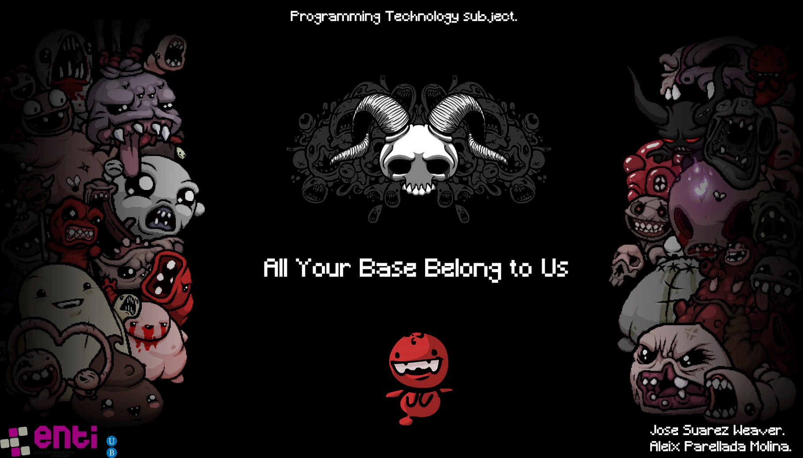

Slide 2
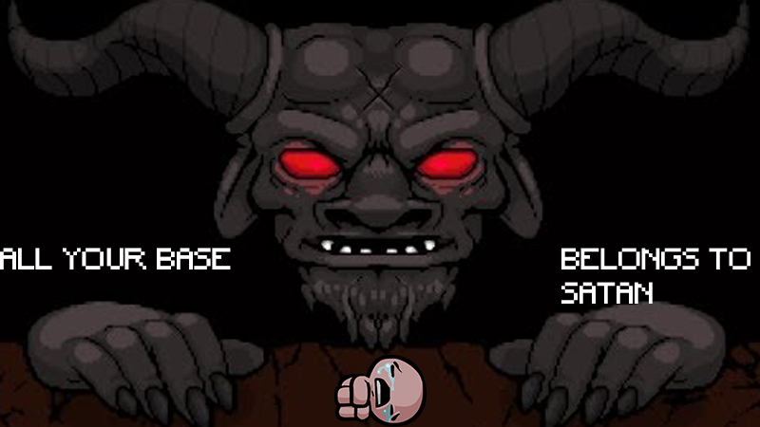
Main features
Goal: Survive as much as you can the waves of enemies, if you or your base get destroyed, you’ll lose immediately.

Slide 3
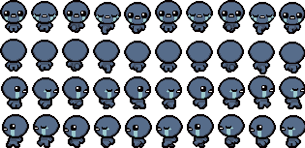
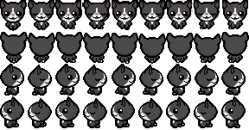

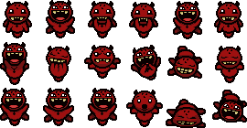
Characters
Isaac.
Guppy.
Function:
MainCharacter.
Secret transformation.
NPC.
Enemy.
Function:
Walk in the same route eternally.
Function:
Destroy the base.
Mock the mainCharacter with copies.

Slide 4



Objects
They upgrade some characters attributes:
Adds AttackPower.
Grants the Character more velocity.
Gives the Character more Health.

Slide 5
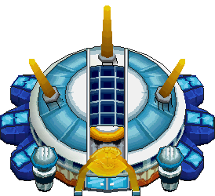
Base
Sooner or later it’ll get destroyed it’s just a matter of time.

